Slide 1
Revising Unit Testing
How to test, not what to test

Slide 2
What is Unit Testing?
  Testing the smallest parts of your code to confirm they work correctly
    Our smallest parts are methods
  Why do it?
    Eliminate/detect potential problems starting at the lowest level
    Confirm the individual pieces function correctly before you try to combine them

Slide 3
Basic Unit Testing - What’s Involved?
  Identify appropriate test cases
    Input
    Expected output/error
  For each test case, write a test!
    Establish the input being tested
    Establish the expected result
    Run the method
    Check the result:
      Where an error/exception is expected, assert this has happened
      Where an error is not expected, assert the returned value matches the expected result
    Check for side-effects
Simple?
Not really…

Slide 4
Identifying Appropriate Test Cases
  Guard against developers hurting themselves
    How can the programmer using your code use it incorrectly?
    What are the assumptions being made about the data being provided?
  Guard against users entering incorrect information
    What will happen if the user doesn’t provide valid information?
    What will happen if the user doesn’t provide accurate information?
  Confirm resulting information is complete/correct
    Where the user and developer act appropriately, does your code result in complete/correct information being returned?

Slide 5
Unit Testing Database Code
  Database code can be separated into two categories:
    Query-based code (select)
    Update-based code (insert/delete/update)
  When testing code involving a database, there are a couple of things to keep in mind:
    Confirm the database actually changes
    Never test on a live database!

Slide 6
Query-Based vs Update-Based Code
  The difference between query-based and update-based code is the presence/absence of external impacts
    Query-based code does not change the database
    Update-based code may change the database
  Difference actions require different approaches to the assertion stage:
    Query-based: Assert return values are correct
    Update-based:
      Assert return values are correct
      Confirm database has been impacted correctly

Slide 7
Confirming Database Changes
  Confirming a(n) delete/insert: Can you select the item after insertion?
  Confirming an update: When you select the item:
    Have the updated fields been changed as expected?
    Have the unedited fields remained unchanged?
  In both cases, we need to use another database accessing method to achieve this
    As with data structures where we needed to use other methods from the class to confirm the method being tested worked correctly
    Luckily selects are stand-alone and can be confirmed to work independent of other methods!

Slide 8
Final Note: Test Clean Up
  We want to be able to run tests repeatedly
  Test results need to be based on a predictable dataset
    The test database changes when we test updates, inserts and deletes
    We don’t know in what order these tests will execute
    We don’t know which have succeeded and which have failed
  To avoid issues with predictability, we can disable auto-commit

Slide 9
Test Database:
Providing a Safe Space to Test
  Live database: main database connected to the system
  Live databases are unsuitable for testing due to their unpredictability
    Tests are based on being able to predict outcomes – asserting values
  Testing on a live database risks corrupting real data
    If your test changes the data in a live database, a real user is impacted
  Solution: create a test version of the database
    Duplicate schema with a smaller test set
  Design your code to allow for injection of the database name
    Tests can use the test version of the database. Real code can use the live one.

Slide 10
AutoCommit – Not Always Helpful!
  By default, JDBC connections are set to auto-commit all SQL actions
    The result of the action is persisted in the database even after the connection closes
  When testing JDBC code integrated with a database, we do not want to persist our schema changes!
    Persisting these changes means the tests cannot rerun with consistent results
  To avoid this issue, we should turn off auto-commit on the connection before calling the method being tested
    Not necessary to roll back the action after the test has completed – turning off auto-commit stops changes being persisted without an explicit call to commit
  This ensures:
    The impact of the action will persist while the connection is open (we can confirm it worked)
    The test database will not be permanently changed once the test is complete

Slide 11
Write for Test Reusability:
Parameterising Tests
  By default, tests are written for one specific test case:
    Test where a match can be found for an ID
    Test where a match cannot be found for an ID
  Often we find test structure repeats, only the values change
    Essentially clustering by test type, e.g. valid input, invalid input
  We can reuse tests by supplying them with parameters!
    Mark test as @ParameterizedTest
    Write test with input and expected results as parameters
    Rerun it with each set of parameters

Slide 12
Parameterized Tests:
@MethodSource to Supply Parameters
  JUnit does not support non-standard types as parameters for parameterised tests
  To solve this, we can write a method that supplies these parameters as a Stream of values
    The stream can contain whatever types we want
  If we want to supply multiple parameters for each method run, we use Arguments
    Arguments represent a single test run’s parameter data

Slide 13
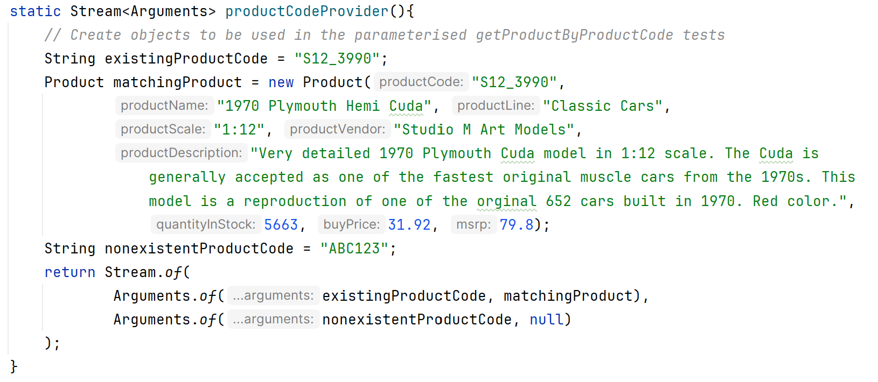
Example of a MethodSource Method
Static
method
Each Argument contains the data for a single test case:
input and expected result
Returns stream of Arguments
Full code found in /test/week06_testing_and_properties.persistence/ProductDaoImplTest

Slide 14
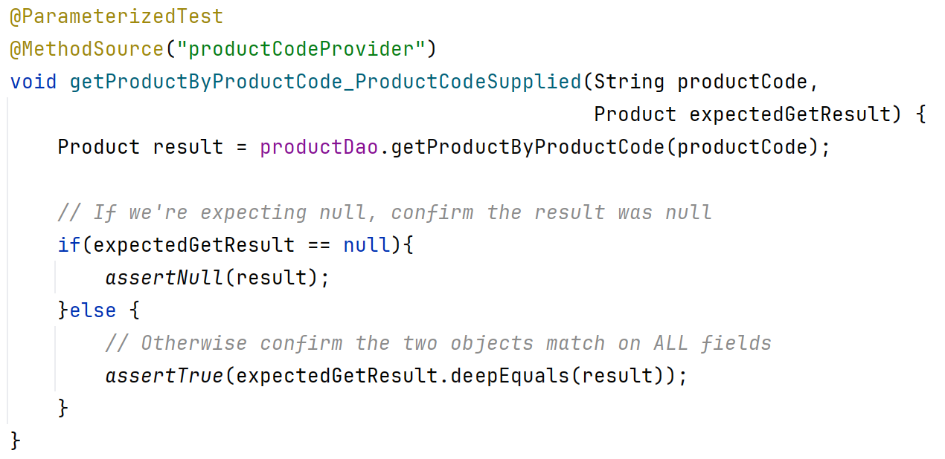
Example of an @ParameterizedTest Using a MethodSource
State the name of the method supplying the parameters
Mark test as Parameterized
List the parameters used in the test
Much cleaner test!!
Full code found in /test/week06_testing_and_properties.persistence/ProductDaoImplTest

Slide 15
Sample Tests in In-Class Git Repo
  Sample select: getProductByProductCode ()
    Single phase test – check result to confirm action was correct
  Cases covered:
    Retrieving a product that exists
    Retrieving a product that does not exist
    Retrieving a product using a null product code
  Sample insert: addProduct()
    Two-phase test – check result to confirm result was correct, check database to confirm action was successful
  Cases covered:
    Adding a product whose productCode does not already exist
    Adding a product whose productCode already exists
    Adding a product whose productCode is null
    Adding a product where the overall product is null
Don’t forget to use @BeforeEach for test set up
Tests found in /test/week06_testing_and_properties.persistence

